Slide 1
Pathological Affection of digestive system
Pathology of oral cavity
By Dr.yasmeen jasim

Slide 2
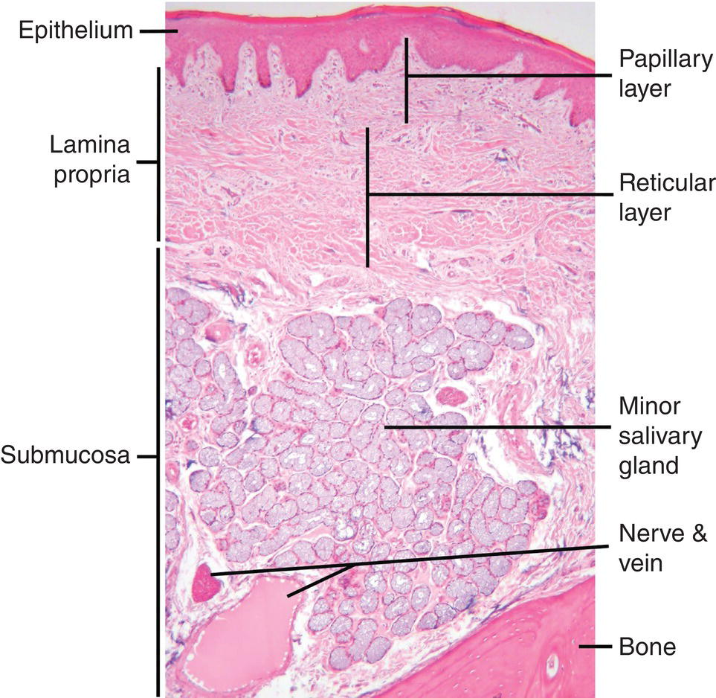
Histological structure of oral cavity

Slide 3
Gingivitis
Gingivitis : is form of gum diseases means inflammation of the gums, or gingiva . Gingivitis is common in dogs and cats and refers to inflammation of the gingiva in response to plaque antigen

Slide 4
Causes
Gingivitis is caused by the buildup of plaque–– a naturally-occurring sticky film containing bacteria – on the teeth and gums. The bacteria found in plaque produce toxins that can irritant the gums become red, inflamed, and lead to bleeding

Slide 5
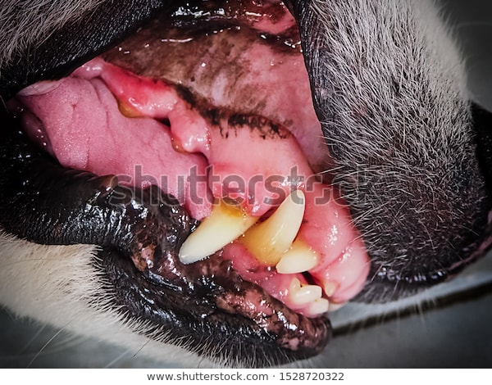
Gross features of gingivitis
gums are red and swollen
gums are bleed when you brush teeth
loose teeth
a change in teeth fit together)
pus between teeth and gums
pain when chewing
foul-smelling breath

Slide 6
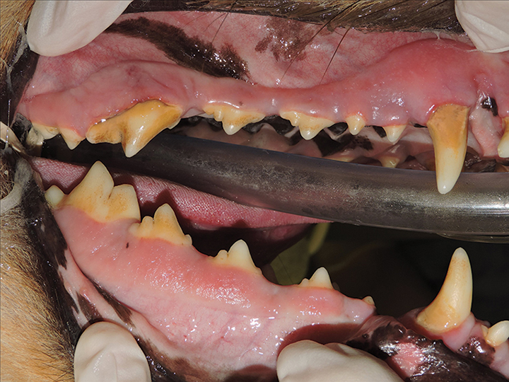

Slide 7
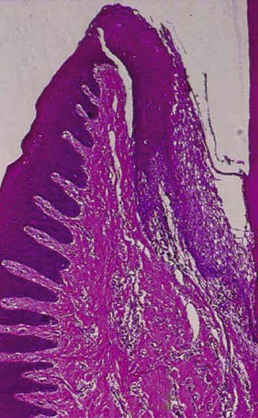
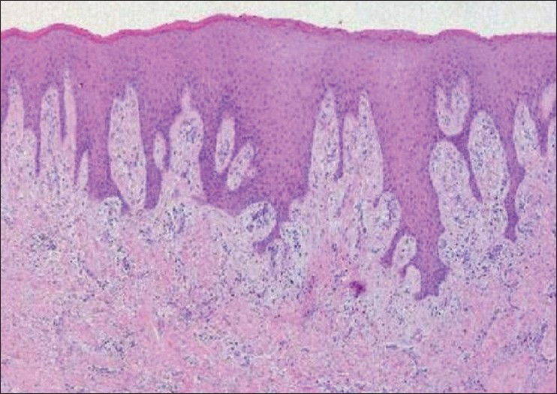
Microscopic feature of gingivitis
Organ:gum
Diagnosis :gingivitis
lesions:( hyperplastic epithelium, chronic inflammatory cells in the connective tissue)
hyperplastic epithelium
chronic inflammatory cells in the connective tissue

Slide 8
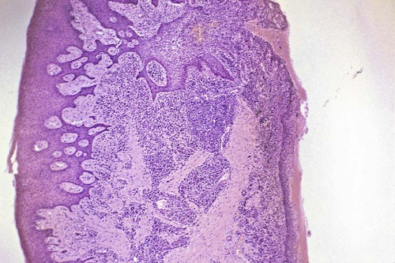
section of chronic inflammation of gingival showing the inflamed and enlargement connective tissue core and strands of proliferating epithelium ,also to infiltration inflammatory cells

Slide 9
Foot and mouth disease
Foot and mouth disease (FMD) is a severe, highly contagious viral disease of livestock that has a significant economic impact. The disease affects cattle, swine sheep, goats and other cloven-hoofed ruminants.
Causes
FMD is caused by a virus called Aphthus virus.
Signs of illness can appear after an incubation period of 1 to 8 days

Slide 10
Signs
Marked rise in body temperature for 2 to 3 days.
Vesicles (blisters) formation in the mouth and on the feet.
Vesicles rupture and discharge clear or cloudy fluid, leaving eroded areas or ulceration
Reduced consumption of feed due to painful tongue and mouth lesions.
Excessive salivation ( sticky, foamy, stringy saliva)
lameness

Slide 11
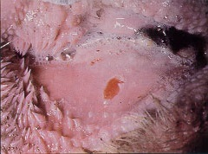
Gross feature organ: gum
Lesions Ruptured viscales producing erosive lesion of the gum

Slide 12
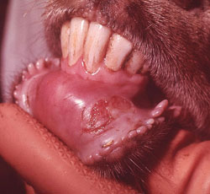
elongate erosion (ruptured vesicle)

Slide 13
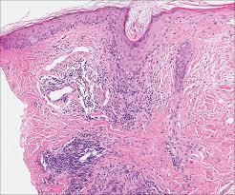
Microscopic features
Ruptured viscals producing erosive and ulcer lesion of the epithelium .
elongate erosion (ruptured vesicle) ventral to the incisors
Infiltrations of inflammatory cell ( macrophage and neutrophil)s

Slide 14
Wooden tongue
Wooden tongue is a well-defined disease of the soft tissues of the mouth region in adult cattle. It is caused by actinobacillos lignieresii, part of the normal bacterial flora of the upper digestive tract. The bacteria usually invade the skin through a wound or minor trauma caused by sticks or straw or barley awns.
Symptoms
Inability to eat or drink
Drooling/ saliva
Rapid loss of condition
Painful and swollen tongue
Ulcers on tongue

Slide 15
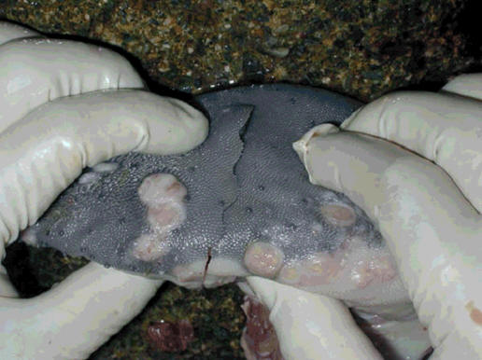
Gross appearance of affecting tongue
Vesicles formation (blisters)
Hardening
Variable sized raised firm
nodules and plaques on
mid dorsal surface of the
tongue

Slide 16
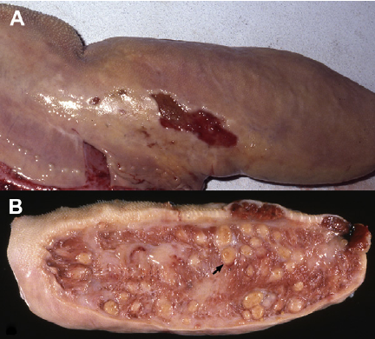
Actinobacillosis or “wooden” tongue. ( A ) The tongue is markedly enlarge with several areas of chronic ulceration along its lateral edge. ( B )
Cross section through a case of wooden tongue with numerous pyogranulomas ( arrow ) scattered throughout the tongue.

Slide 17
Microscopic features
Organ: tongue diagnosis: wooden tongue
lesions: Pyogranulomatou
dermatitis with neutrophils surrounding eosinophilic club-like rosettes,
Necrosis

Slide 18
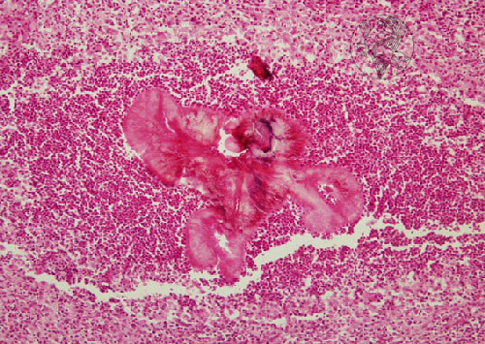
Organ: tongue diagnosis: wooden tongue
Lesions:
Development of
Granulemetus Lesions
Collection of inflammatory
cells(macrophages,
plasmocytes and lymphocytes
-Necrosis and abcesses

